Slide 1
Attendance management using face recognition

Slide 2
Face Detection:
it has the objective of finding the faces (location and size)
in an image and probably extract them to be used by the face recognition algorithm.
Face Recognition:
with the facial images already extracted, cropped, resized and usually converted to grayscale, the face recognition algorithm is responsible for finding characteristics which best describe the image.

Slide 3
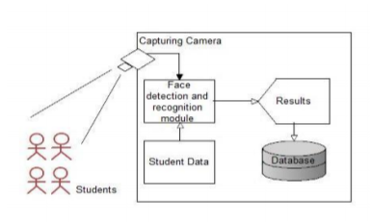

Slide 4
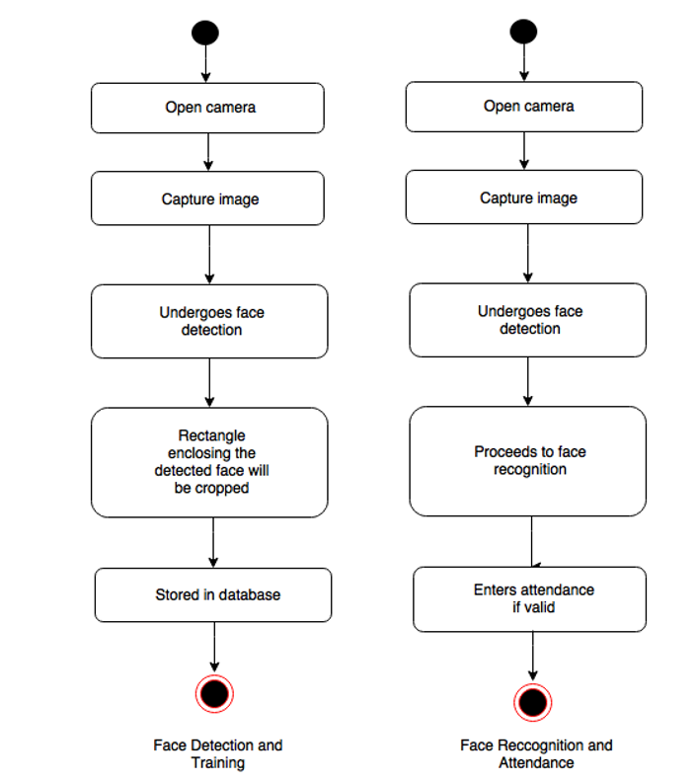

Slide 5
Open Source Computer Vision
OpenCV is a library of programming functions mainly aimed at real-time computer vision. It is a classifier that helps in processing the images.
It comes with the Face Detection class for face detection. To perform the face detection, the following modules need to be imported.
1. cv2 – It is an OpenCV package object or module and has the functions image processing. 2. numpy – The image will be stored in numpy arrays.

Slide 6
Face Detection : Haar Cascade
It is a machine learning object detection algorithm used to identify objects in an image or video .
Proposed by Paul Viola and Michael Jones in their paper "Rapid Object Detection using a Boosted Cascade of Simple Features" in 2001
It is a ml based approach where a cascade function is trained from a lot of positive and negative images. It is then used to detect objects in other images.

Slide 7
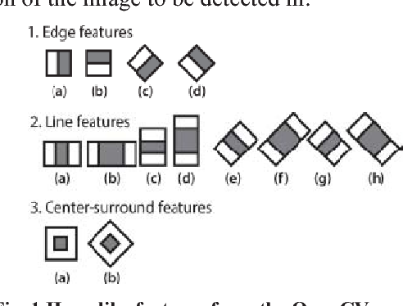
Haar Feature Selection

Slide 8
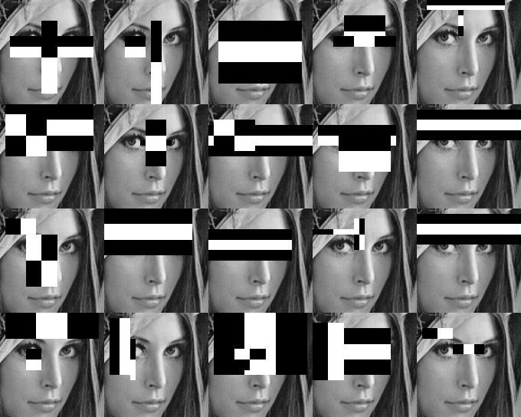
Creating Integral Images

Slide 9
Face Recognition : LBPH
Local Binary Patterns (LBP) is a type of visual descriptor used for classification in computer vision. LBP was first described in 1994 and has since been found to be a powerful feature for texture classification. It has further been determined that when LBP is combined with the Histogram of oriented gradients (HOG) descriptor, it improves the detection performance considerably on some datasets.
Local Binary Pattern (LBP) is a simple yet very efficient texture operator which labels the pixels of an image by thresholding the neighborhood of each pixel and considers the result as a binary number.

Slide 10
Parameters: the LBPH uses 4 parameters:
Radius: the radius is used to build the circular local binary pattern and represents the radius around the central pixel. It is usually set to 1.
Neighbors: the number of sample points to build the circular local binary pattern. Keep in mind: the more sample points you include, the higher the computational cost. It is usually set to 8.
Grid X: the number of cells in the horizontal direction. The more cells, the finer the grid, the higher the dimensionality of the resulting feature vector. It is usually set to 8.
Grid Y: the number of cells in the vertical direction. The more cells, the finer the grid, the higher the dimensionality of the resulting feature vector. It is usually set to 8.

Slide 11
